Slide 1
finding A row combination and finding U N dist

Slide 2
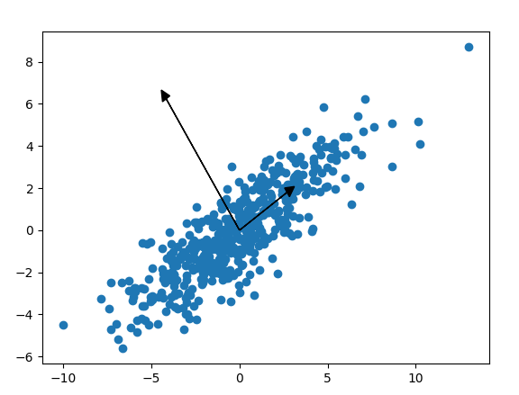
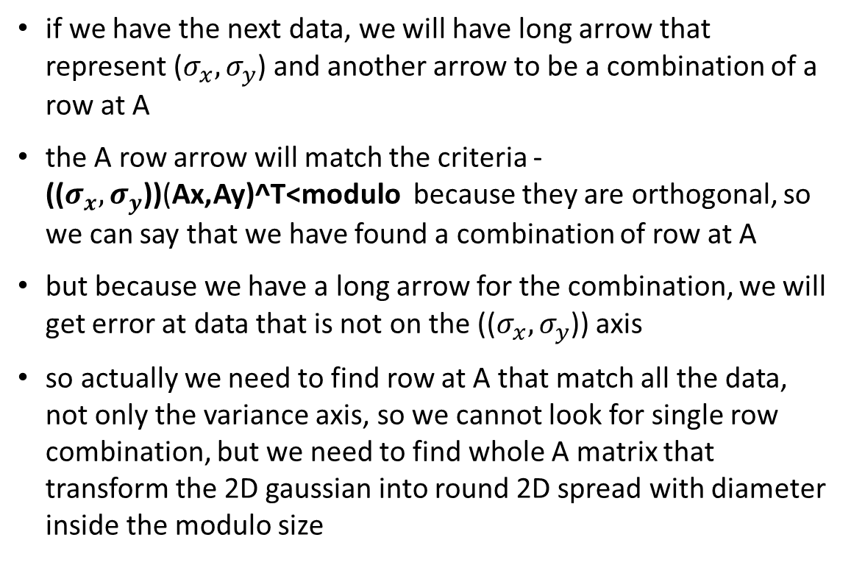
finding combination of row at A
if we have the next data, we will have long arrow that represent ($σ_{x},σ_{y}$) and another arrow to be a combination of a row at A
the A row arrow will match the criteria - (($σ_{x},σ_{y}$))(Ax,Ay)^T<modulo because they are orthogonal, so we can say that we have found a combination of row at A
but because we have a long arrow for the combination, we will get error at data that is not on the (($σ_{x},σ_{y}$)) axis
so actually we need to find row at A that match all the data, not only the variance axis, so we cannot look for single row combination, but we need to find whole A matrix that transform the 2D gaussian into round 2D spread with diameter inside the modulo size

Slide 3
using kurtosis to find if channel output is U or N dist
I though of 2 ways for finding if our output is uniform or normal distributed, so we will have criteria if we don’t have big errors at the channel
probably there are more ways…

Slide 4
using kurtosis
kurtosis output for uniform is -1.2 and for normal is 0
the problem with this method is that we need a lot of samples so the kurtosis will be reliable
I tried to run a lot of simulations per different number of samples and it seems (not surprisingly) that we need about 50 samples to decide if it’s U or N

Slide 5
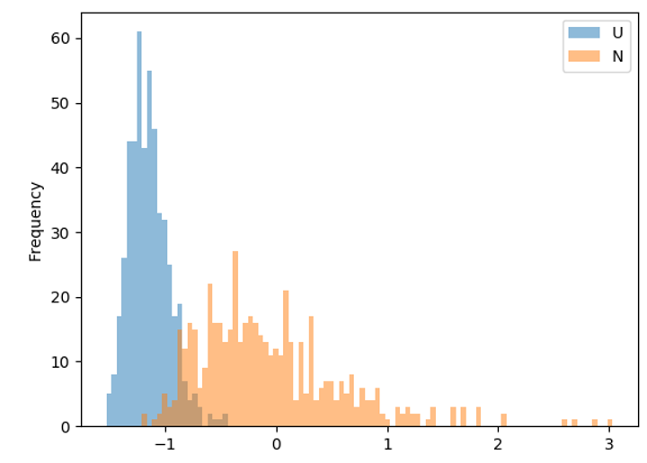
example
at each simulation I random 50 samples of uniform and 50 of normal
each simulation output gave we kurtosis of what I random for N and for U
I ran about 500 simulations and did histogram on it
we can see that uniform is about -1.2 but sometimes it goes above -1

Slide 6
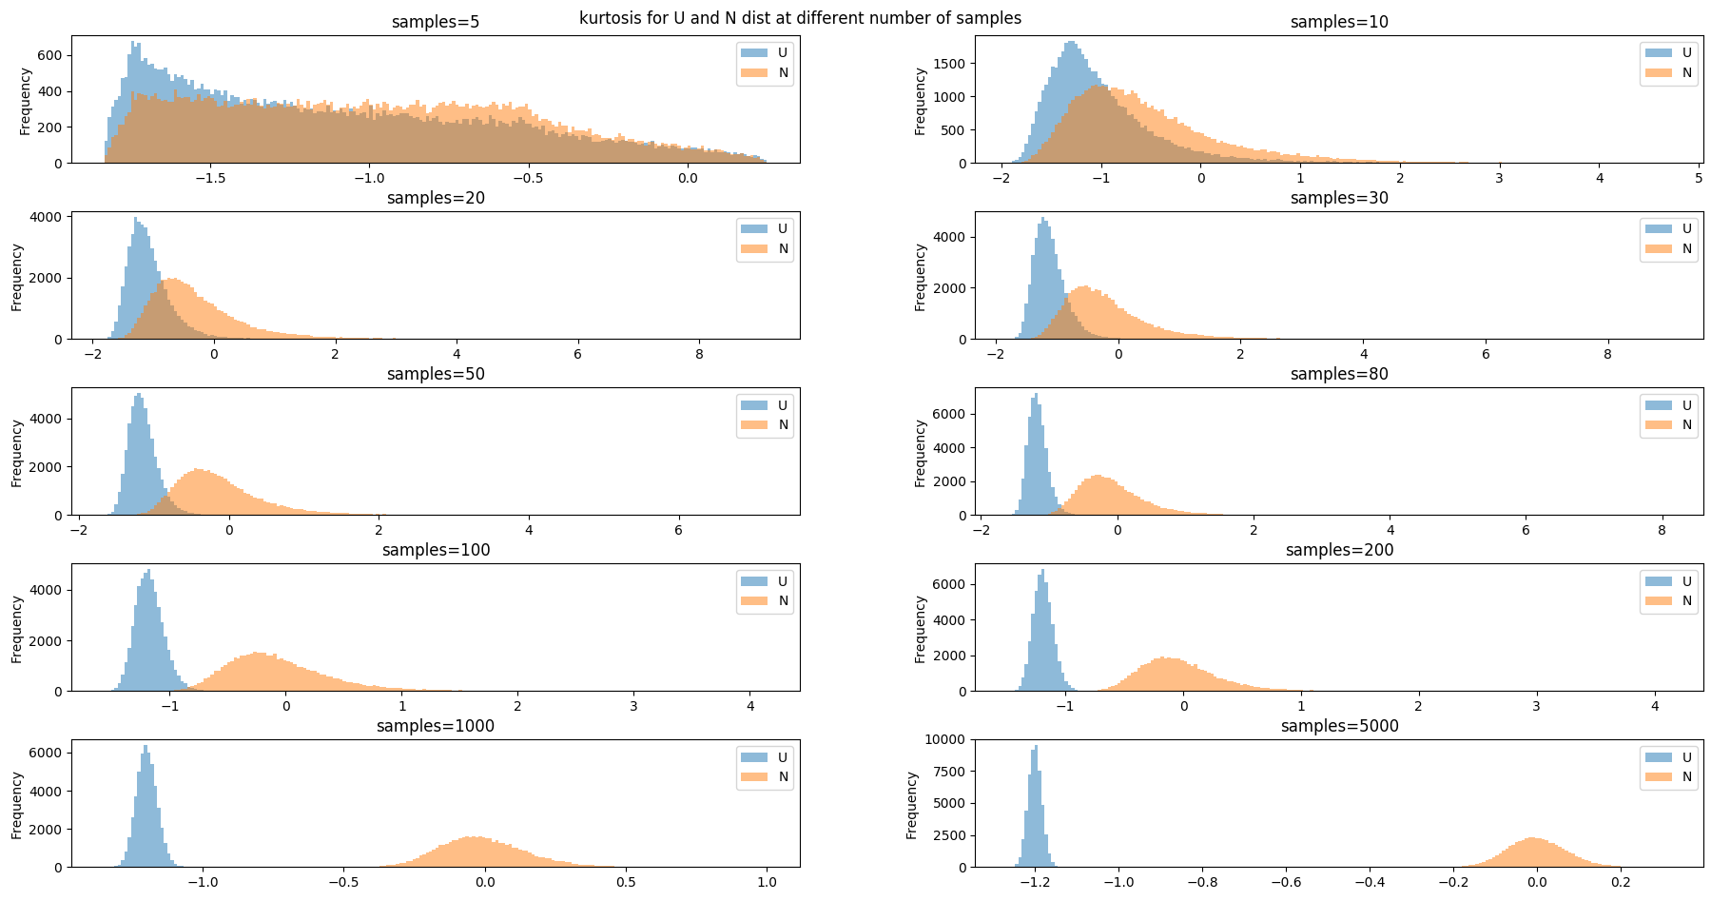
kurtosis at different number of samples

Slide 7
another approach – look at the edge of the modulo
I can just look at the inner edge of the modulo and if I have a sample at that area, I’ll decide that it’s likely to be uniform

